Slide 1
Stochastic Signal Processing
Experiment 3

Slide 2
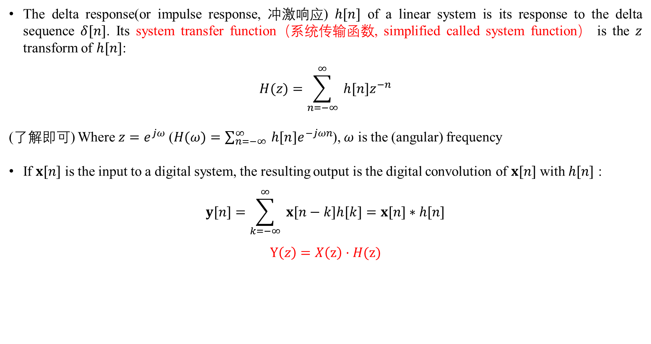
Discrete-time process – linear system (page 8 of lesson 10)
The delta response(or impulse response, 冲激响应) $h[n]$ of a linear system is its response to the delta sequence $δ[n]$. Its system transfer function（系统传输函数, simplified called system function） is the $z$ transform of $h[n]$:
$$H(z)=\sum_{n=−∞}^{∞}{ }h[n]z^{−n}$$
(了解即可) Where $z=e^{jω}$ ($H(ω)=\sum_{n=−∞}^{∞}{ }h[n]e^{−jωn}$), $ω$ is the (angular) frequency
If $x[n]$ is the input to a digital system, the resulting output is the digital convolution of $x[n]$ with $h[n]$ :
$$y[n]=\sum_{k=−∞}^{∞}{ }x[n−k]h[k]=x[n]∗h[n]$$
$$Y\left(z\right)=X\left(z\right)·H(z)$$

Slide 3
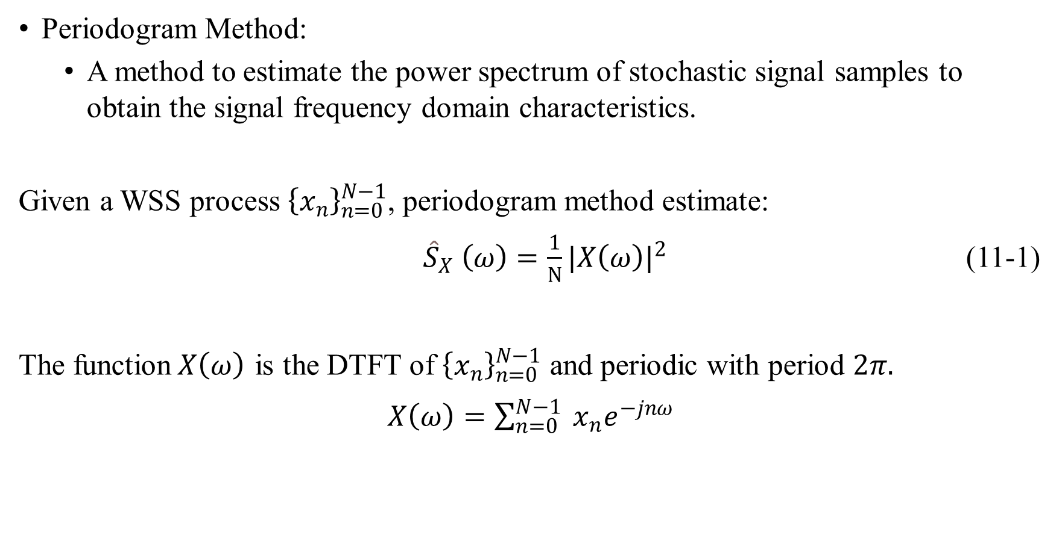
Power spectrum
Periodogram Method:
A method to estimate the power spectrum of stochastic signal samples to obtain the signal frequency domain characteristics.
Given a WSS process ${\left\{x_{n}\right\}}_{n=0}^{N−1}$, periodogram method estimate:
${\hat{S}}_{X} \left(ω\right)=\frac{1}{N}{|X\left(ω\right)|}^{2}$ (11-1)
The function$X\left(ω\right)$ is the DTFT of ${\left\{x_{n}\right\}}_{n=0}^{N−1}$ and periodic with period $2π.$
$X\left(ω\right)=\sum_{n=0}^{N−1}{ }x_{n}e^{−jnω}$

Slide 4
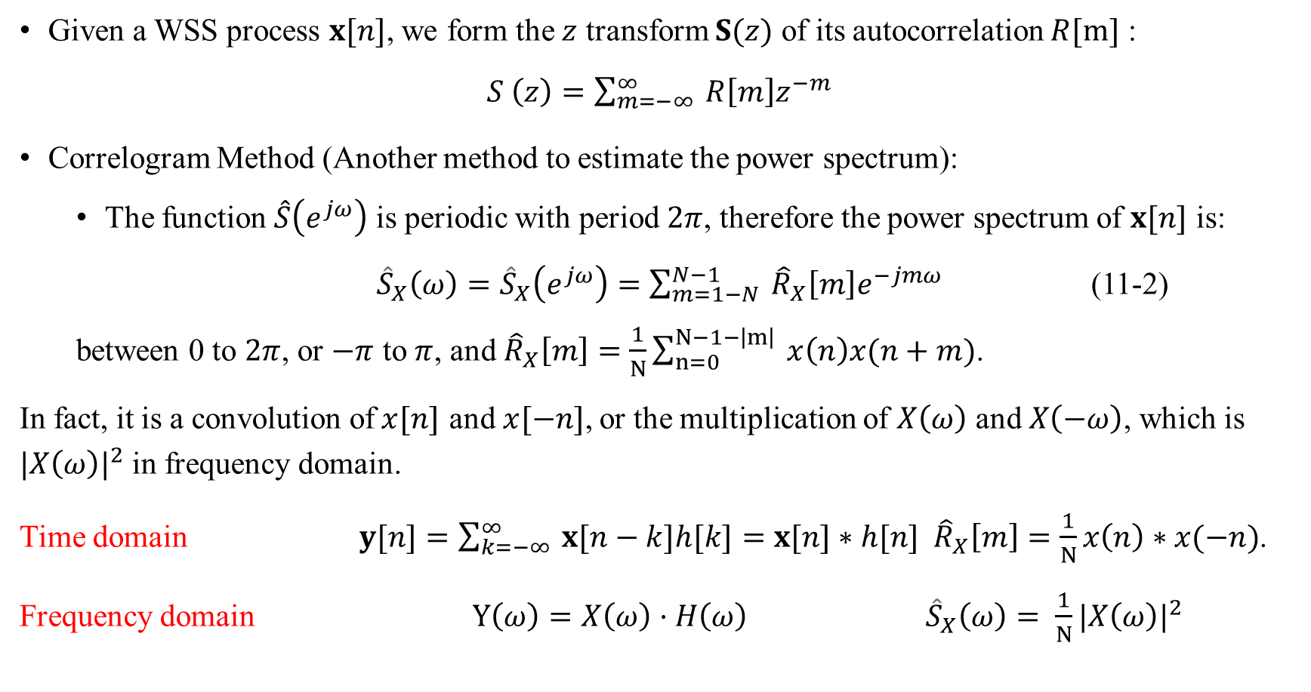
Discrete-time process – Power spectrum (page 10 of lesson 10)
Given a WSS process $x[n]$, we form the $z$ transform $S(z)$ of its autocorrelation $R[m]$ :
$S \left(z\right)=\sum_{m=−∞}^{∞}{ }R\left[m\right]z^{−m}$
Correlogram Method (Another method to estimate the power spectrum):
The function $\hat{S}\left(e^{jω}\right)$ is periodic with period $2π$, therefore the power spectrum of $x[n]$ is:
${\hat{S}}_{X}\left(ω\right)={\hat{S}}_{X}\left(e^{jω}\right)=\sum_{m=1−N}^{N−1}{ }{\hat{R}}_{X}\left[m\right]e^{−jmω}$ (11-2)
between 0 to $2π$, or $−π$ to $π$, and ${\hat{R}}_{X}\left[m\right]=\frac{1}{N}\sum_{n=0}^{N−1−\left|m\right|}{ }x\left(n\right)x(n+m)$.
In fact, it is a convolution of$x[n]$ and$x[−n]$, or the multiplication of $X\left(ω\right)$ and $X\left(−ω\right)$, which is ${|X\left(ω\right)|}^{2}$in frequency domain.
Time domain $y[n]=\sum_{k=−∞}^{∞}{ }x[n−k]h[k]=x[n]∗h[n]$ ${\hat{R}}_{X}\left[m\right]=\frac{1}{N}x\left(n\right)∗x(−n)$.
Frequency domain $Y\left(ω\right)=X\left(ω\right)·H\left(ω\right)$ ${\hat{S}}_{X}\left(ω\right)=$ $\frac{1}{N}{|X\left(ω\right)|}^{2}$

Slide 5

Power spectrum
More about the Autocorrelation:
$${\hat{R}}_{X}\left[m\right] =α\sum_{n=0}^{N−1−\left|m\right|}{ }x\left(n\right)x(n+m)$$
When $α$= $\frac{1}{N}$ , the estimation is biased. Therefore
$E\left({\hat{R}}_{X}\left[m\right]\right)=\frac{N−|m|}{N}R_{X}\left[m\right]$ = $w_{N}\left(n\right)R_{X}\left[m\right]$
And $E\left({\hat{S}}_{X}\left(ω\right)\right)=\sum_{m=1−N}^{N−1}{w_{N}\left(m\right)R_{X}\left[m\right] e^{−jmω}}$

Slide 6
Experiment – power spectrum
Function periodogram in Matlab
pxx = periodogram(x) % using the default rectangular window and returns the periodogram power spectral density (PSD) estimate
pxx = periodogram(x, window, nfft) %uses nfft points in the discrete Fourier transform (DFT).
Common window function in matlab
name | Matlab function
矩形窗 | rectwin
三角窗 | triang
Hamming | hamming

Slide 7
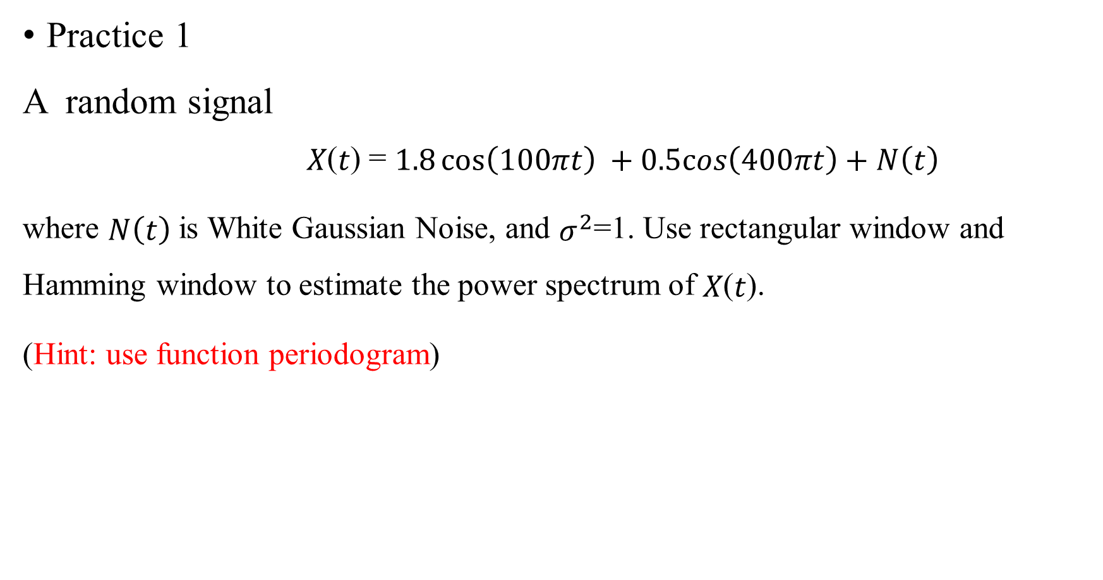
Experiment – power spectrum
Practice 1
A random signal
𝑋(𝑡) = $1.8\cos\left(100πt\right) +0.5cos\left(400πt\right)+N\left(t\right)$
where $N\left(t\right)$ is White Gaussian Noise, and $σ^{2}$=1. Use rectangular window and Hamming window to estimate the power spectrum of 𝑋(𝑡).
(Hint: use function periodogram)

Slide 8
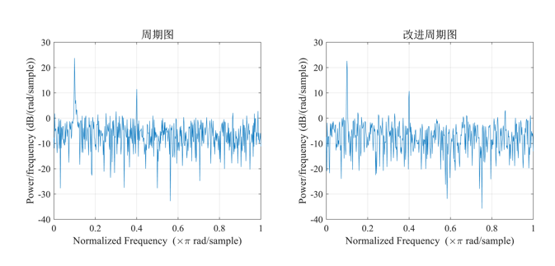
Experiment – power spectrum
fs = 1000; % sample rate
f1 = 50; %
f2 = 200; %
t = 0:1/fs:1-1/fs; % sample point
x = 1.8*cos(2*pi*f1*t)+0.5*cos(2*pi*f2*t) + randn(size(t)); % length 1s
subplot(1,2,1)
periodogram(x,rectwin(length(x))); % Periodogram with rectangular Window
set(gca,'fontsize',12,'fontname','times');
title('\fontname{} Periodogram ','fontsize',14);
subplot(1,2,2)
periodogram(x,hamming(length(x))); % Periodogram with Hamming Window
set(gca,'fontsize',12,'fontname','times');
title('\fontname{} Modified Periodogram','fontsize',14);
set(gcf,'Units','centimeter','Position',[10 10 28 10]);

Slide 9

Experiment – power spectrum
Practice 1
Formula: $ω$ = 2 $π$ $f/$ $f_{s}$
Maximum values appear in $ω$=0.1$π$ and $ω$=0.4$π$, corresponding to $f$=50$Hz$and 𝑓=200Hz,
Hamming window is able to reduce side lobe, especially in 𝜔=0.1𝜋 .

Slide 10
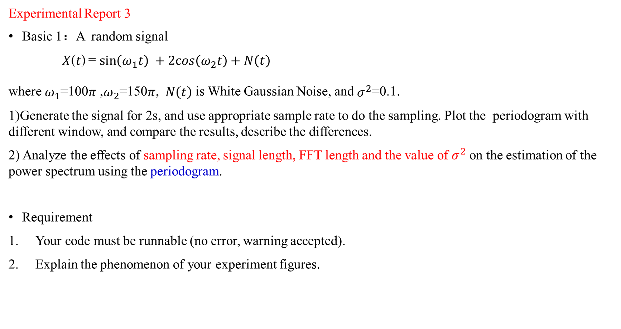
Experimental Report 3
Basic 1：A random signal
𝑋(𝑡) = $\sin\left(ω_{1}t\right) +2cos\left(ω_{2}t\right)+N\left(t\right)$
where $ω_{1}$=100$π$ ,$ω_{2}$=150$π$, $N\left(t\right)$ is White Gaussian Noise, and $σ^{2}$=0.1.
1)Generate the signal for 2s, and use appropriate sample rate to do the sampling. Plot the periodogram with different window, and compare the results, describe the differences.
2) Analyze the effects of sampling rate, signal length, FFT length and the value of $σ^{2}$on the estimation of the power spectrum using the periodogram.
Requirement
Your code must be runnable (no error, warning accepted).
Explain the phenomenon of your experiment figures.

